Slide 1
Information Visualization Visualization Sketch
G22-A
97155 – João Tiago Aparício
94121 – Diana Lopes
94012 – Jorge Marques

Slide 2
Overview
01

Slide 3
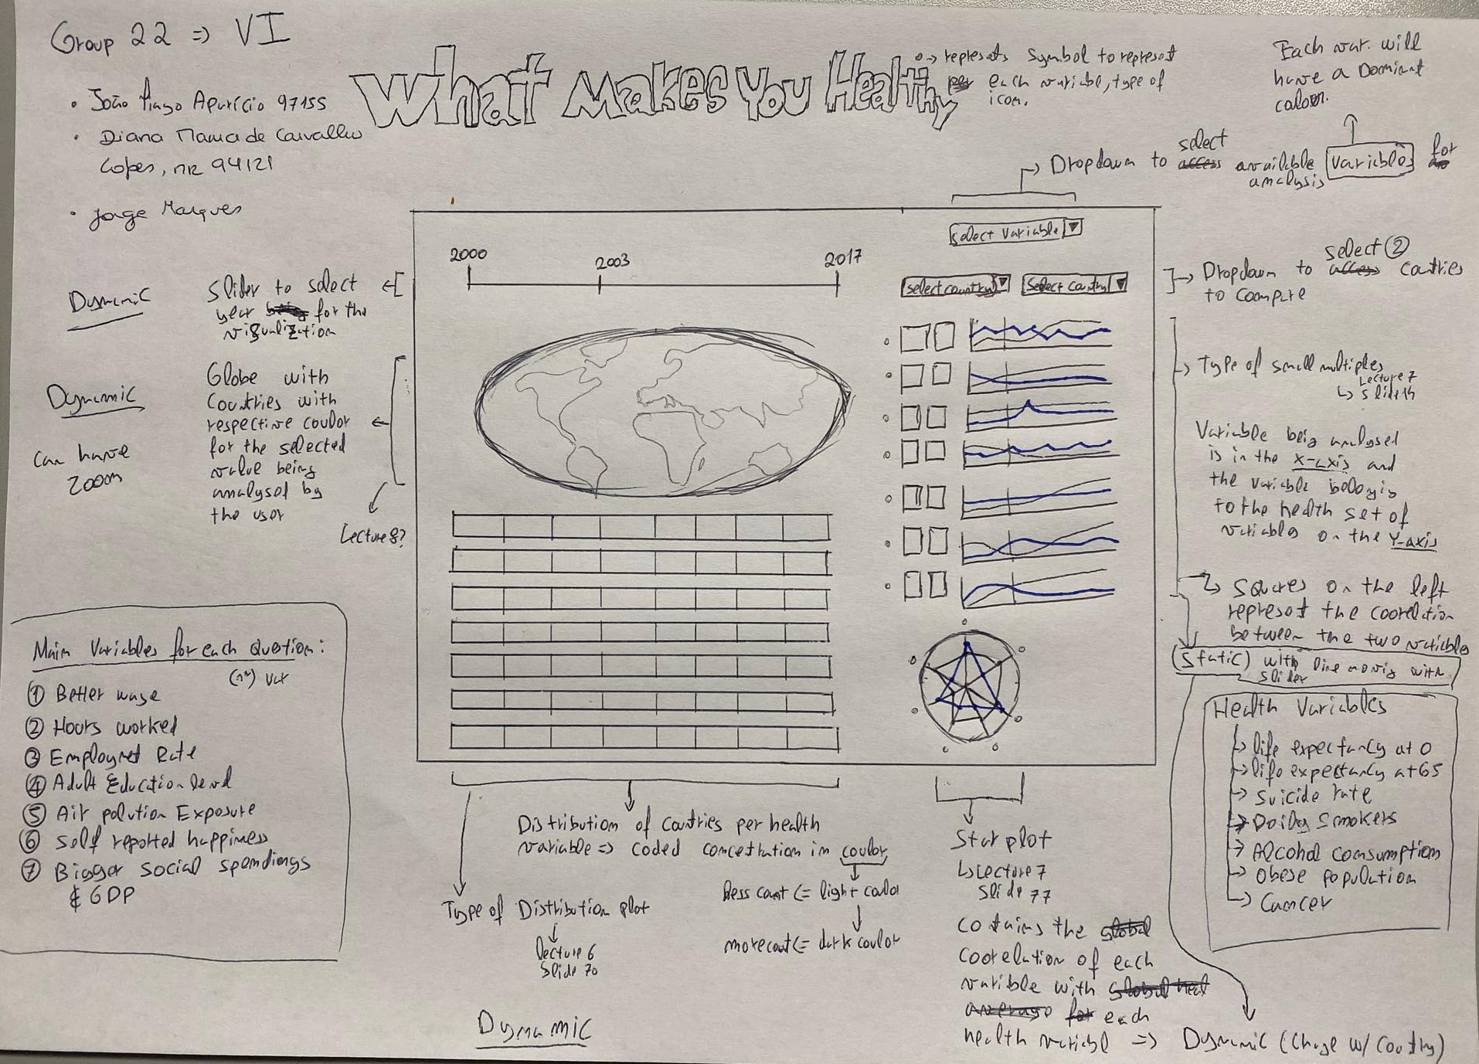
Overview

Slide 4
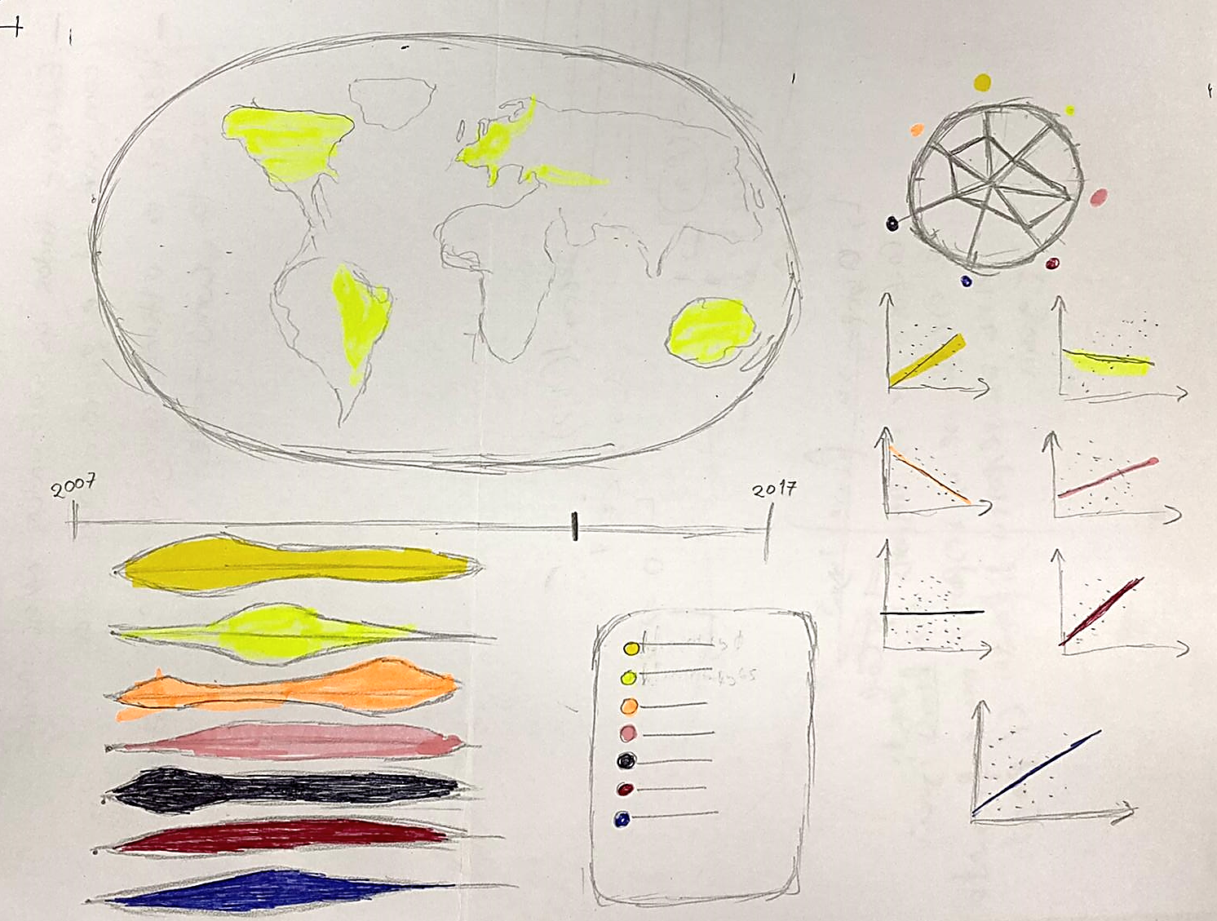
Overview

Slide 5
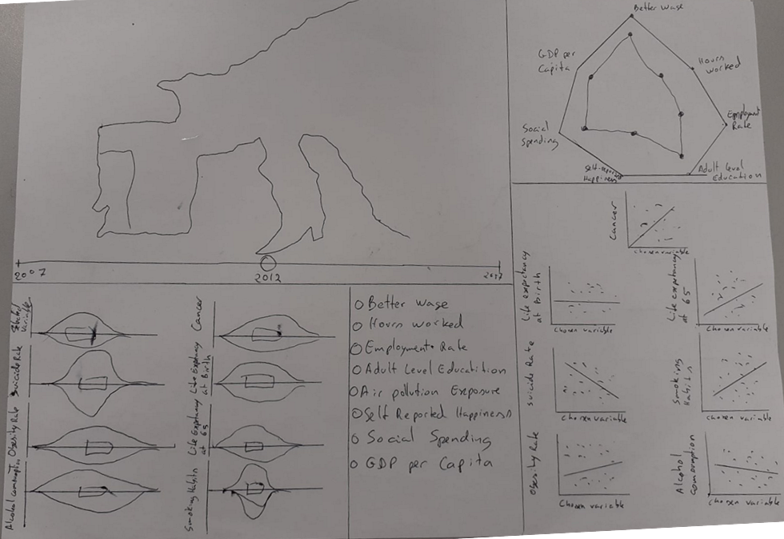
Overview

Slide 6
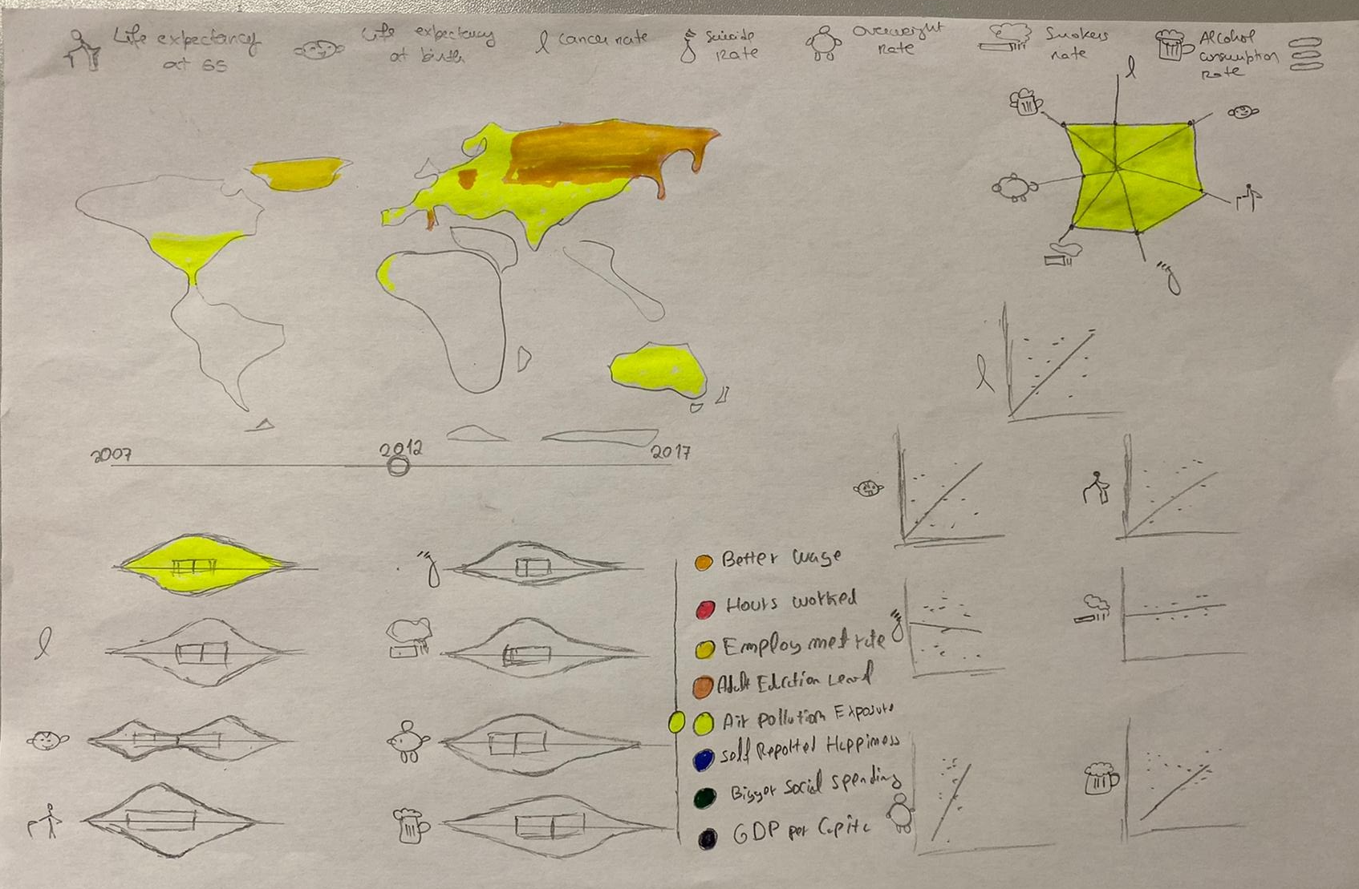
Overview

Slide 7

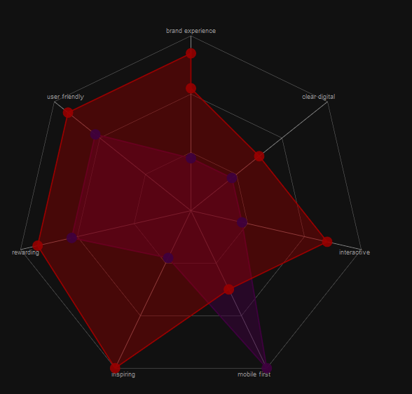

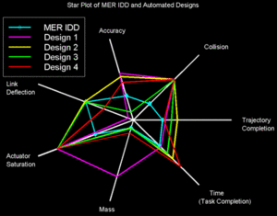


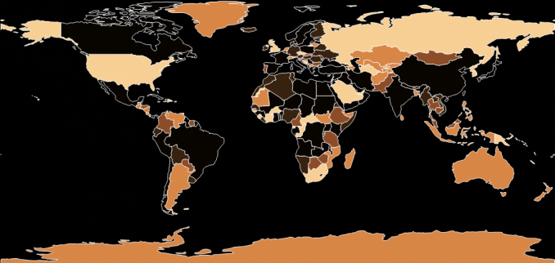




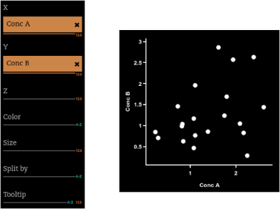

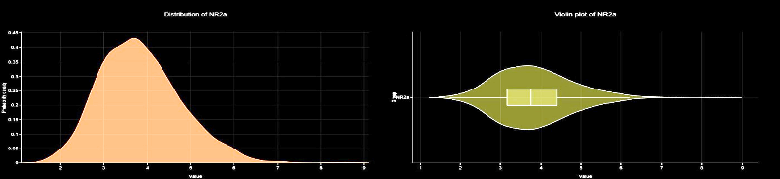
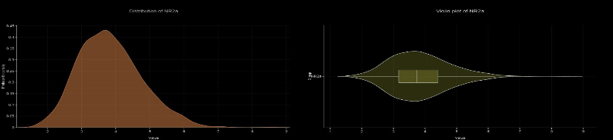

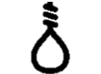
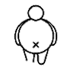
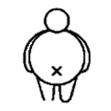

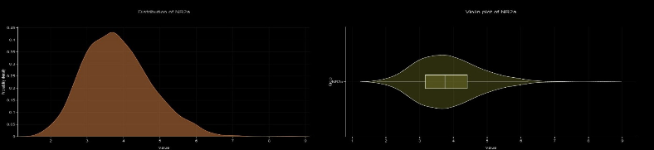

Overview
2007
2012
2017

Slide 8
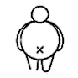

Overview
Life expectancy at 65
Life expectancy at birth
Cancer rate
Suicide rate
Overweight rate
Smokers rate
Alcohol consumption rate
2007
2012
2017

Slide 9
Visual encoding
02

Slide 10
Visual Encoding
Choropleth map health influencers | Relating country with health influencer:
Visual Encoding:
Map -> Colour: filling each country with the colour of the selected variable.
Channel -> colour -> hue: a higher value for the hue represents a higher value of the selected variable.
Channel -> colour -> lightness: if a point from a country is selected on a scatter plot, the lightness goes up on the map.

Slide 11
Visual Encoding
Scatter plot as small multiples| Relation between health factors and influencers:
Visual Encoding:
Marks -> Point: represents a pair (health variable, health influencer)
Marks -> Line: represents the linear approximation of the scatterplot between the 2 variables.

Slide 12
Visual Encoding
Scatter plot as small multiples| Relation between health factors and influencers:
Visual Encoding: (Cont.)
Channel -> position: represents the position of the point in a Cartesian axis.
Pictograph -> Represents the respective health variable being correlated with health influencer

Slide 13
Visual Encoding
Star plot| Correlation coefficient between health influencers and factors:
Visual Encoding:
Marks -> Point: represents the correlation coefficient normalized between 0 and 1.
Channel -> colour -> hue: The colour of the area between the points in the start chart represents the variable being analyzed.
Pictograph -> Represents the respective health variable being correlated with health influencer
Channel -> Colour: coulor represents the selected variable.

Slide 14
Visual Encoding
Violin plot as small multiples| Type:
Visual Encoding:
Pictograph -> Represents the respective health variable
Curve -> Represents the distribution of each of the health variables and the selected health influencer
Size -> Is proportional to cardinality countries of the value interval
Channel -> Colour: the colour of the first violin plot represents the selected variable

Slide 15
Visual Encoding
Health influencer slider| influencer selected for visualization:
Visual Encoding:
Channel -> position: represents the health influencer being displayed
Channel -> colour: represents the health influencer being displayed

Slide 16
Visual Encoding
Years slider| year selected for visualization:
Visual Encoding:
Channel -> position: represents the year being displayed
Channel -> colour: represents the relation between the coulor with each influencer (word on its right)

Slide 17
Visual Encoding
Health influencer legend | influencer selected for visualization:
Visual Encoding:
Channel -> colour: represents the relation between the coulor with each influencer (word on its right)

Slide 18
Answering the Questions
03

Slide 19
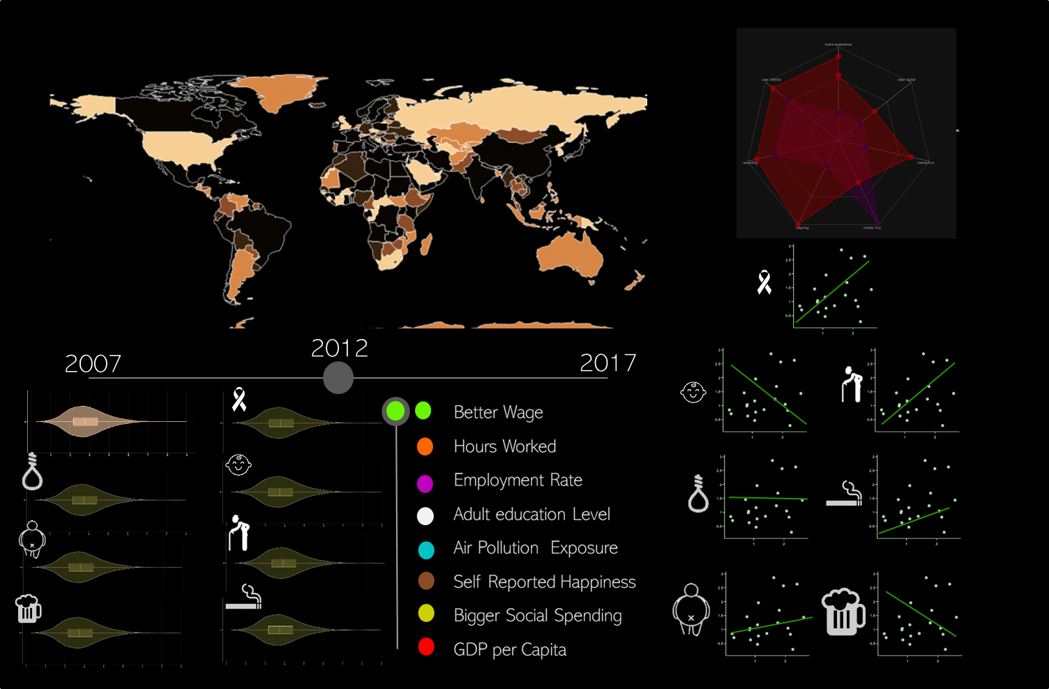

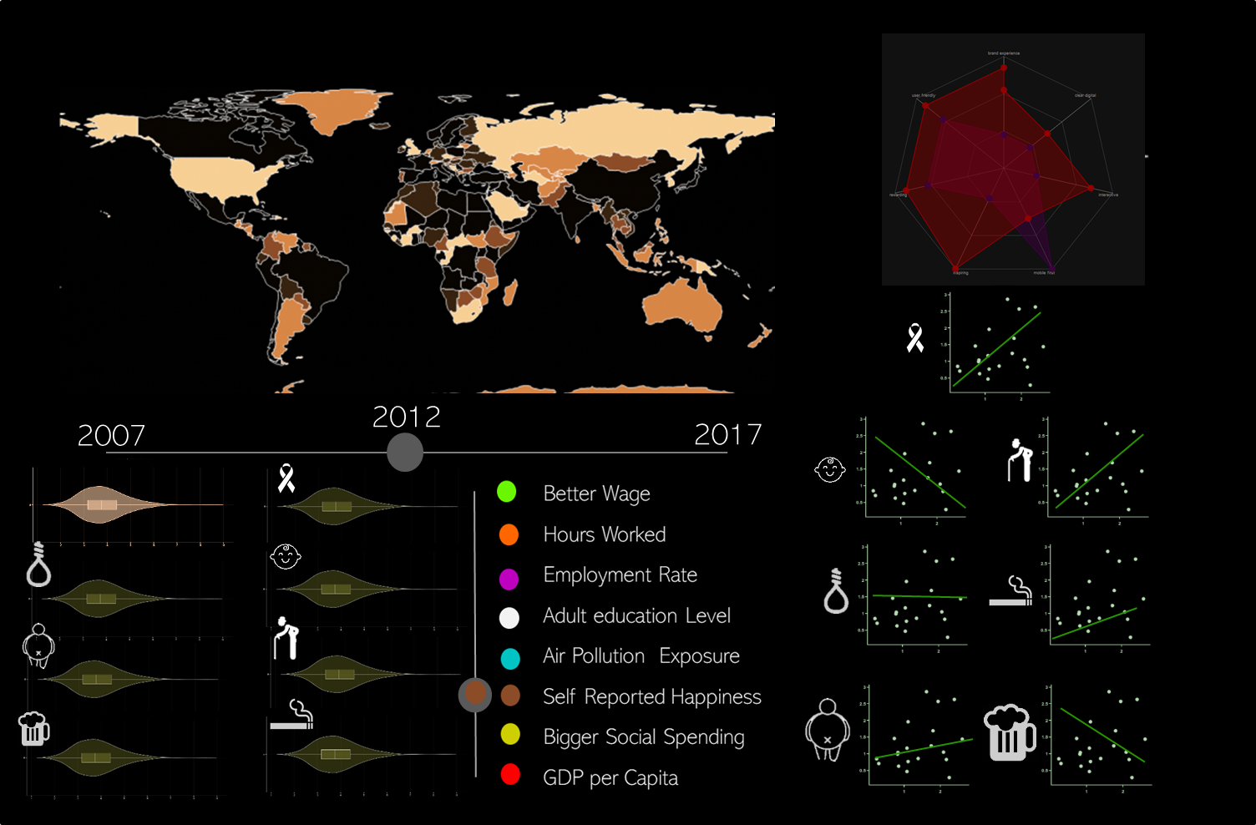

Question 1
Does a better wage mean a healthier life or a longer life expectancy?
Select
Understand the evolution
Is that correlated to health?
Are there many exceptions?
Where?

Slide 20
Questions
Question 2: What is the optimal number of hours to work that lead to a healthier life or more life expectancy?
Question 3: What is the relationship between, more people working and being healthier and live more?
Question 4: How does adult education influence our health?

Slide 21
Questions
Question 5: How does air exposure affect our health?
Question 6: How does self-reported happiness corelates to Alcohol consumption, Smoking habits and Suicide rates?
Question 7: Does a bigger social spending or a higher GDP in general influences people to live more and suicide, smoke and drink less?

Slide 22
Question 2- 7
Process is analogous for other questions.
Select
Understand the evolution
Is that correlated to health?
Are there many exceptions?
Where?

Slide 23

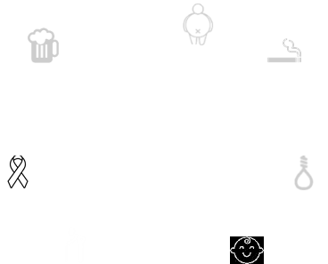
Other interesting questions on the topic
Other questions:
Where is the wage higher?
Are Is there a good correlation between Self reported happiness and drinking alcohol?
Select => Look at the map
Look at star plot in variable selected in alcohol consumption
Why that number?
Look at scatterplot
Select

Slide 24
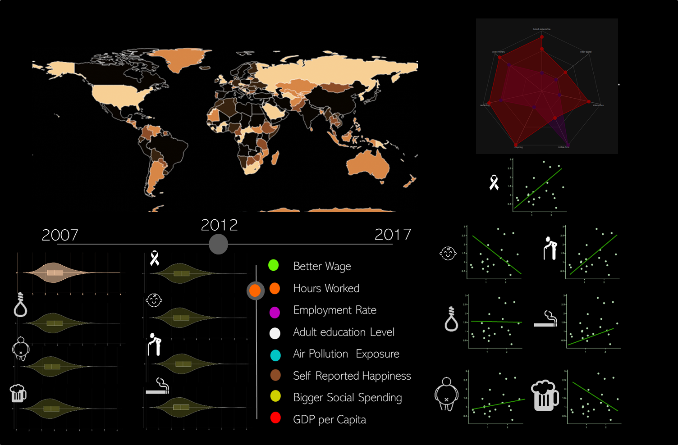
Other interesting questions on the topic
Other questions:
Are people getting unhappier?
Are people in Asia Working more hours?
Look at distributions evolving
Slide
Select
Look at Asia in the map, is the orange “stronger”?
Select

